Slide 1
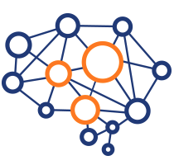
Machine Learning in Context, Part 2
Text and Images
Yordan Darakchiev
Technical Trainer
yordan@softuni.bg

Slide 2
Sli.do
#softuni-ml-2

Slide 3
Table of Contents
Text
Frequencies
Cleaning text data – stopwords, stemming
TF – IDF
Images
Image properties
Filters
Image morphology

Slide 4
Text Processing
Understanding what people write

Slide 5
Text Data
Documents, written in plain text
News, tweets, blog posts, poems, books, legal documents, etc.
May also be auto-generated (i.e. server logs)
Objective
Preprocess the text data so that it's useful to ML algorithms (they expect numbers, not plain text)
Run "classical" algorithms, e.g. for classification
Applications
Sentiment analysis
Grouping texts – similar topics, similar authors
Text summarizing, etc.

Slide 6
Preparing Text Data
Before we start working with the text, we have to "normalize" and clean up the messy data
Remove all non-letter characters
Numbers, punctuation, whitespace, etc.
If needed, apply additional rules, e.g. if we're looking at tweets, @mention means a username and we may want to get rid of it
Transform all characters to lowercase
Remove "stop words"
Words that are too frequent in all documents and don't contain much information such as "the", "a", "is", etc.
Perform stemming
Extract the stems of all words, e.g. "connected", "connection", "connecting" should all point to "connect"

Slide 7
Stopwords and Stemming: NLTK
NLTK is a library for working with natural language
Contains all frequently used algorithms and corpora
Getting and removing stopwords
Download the words first
Stemming – Porter's algorithm (includes many "manual" rules)
nltk.download("stopwords")
from nltk.corpus import stopwords
stop = set(stopwords.words("english"))
sentence = "this is a foo bar sentence"
print([i for i in sentence.lower().split() if i not in stop])
from nltk.stem.porter import *
stemmer = PorterStemmer()
words = ["caresses", "flies", "dies", "seizing", "itemization", "sensational", "traditional", "reference", "plotted"]
print([s.stem(w) for w in words])

Slide 8
Lab: Exploring and Preparing Text Data
Find a dataset of text documents
Use a "bag of words" to show the frequencies of each word
Display a bar chart of word frequencies
Perform text processing
Use NLTK (Natural Language ToolKit) to remove stopwords and perform stemming (if needed)
Display word frequencies again (on the processed data)
What are the most common words? Can you infer something about the text, e.g. topics, sentiment, etc.?
from sklearn.feature_extraction.text import CountVectorizer
cv = CountVectorizer()
cv.fit_transform(text)

Slide 9
Natural Language Processing
A part of text processing which deals with natural languages
Example: Recognizing named entities
People, geographical places, organizations
John worked for Google at the Silicon Valley.
Other examples: recognizing years / date ranges, numbers, sequential steps, etc.
Example 2: Part-of-speech tagging
Boil water in a big vat.
"Boil" is a verb, but may also be a noun => context matters
To do tagging, we have to define a formal grammar
NLTK can then make "parse trees" based on it
Look at this tutorial for more information

Slide 10
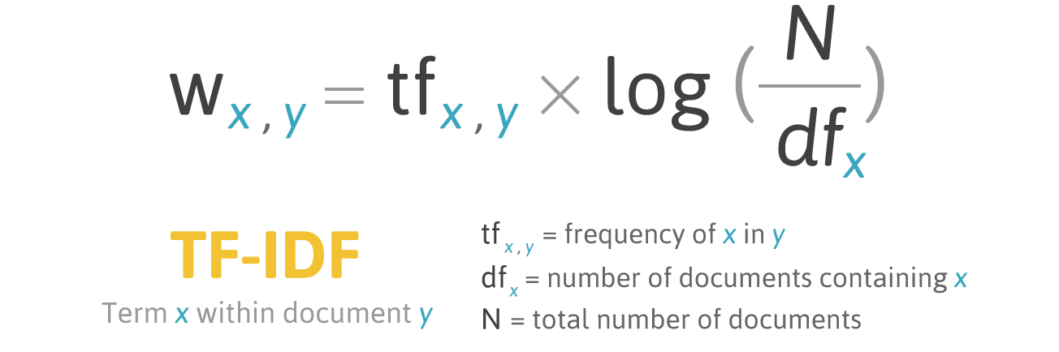
TF – IDF
Term frequency – inverse document frequency
Still preprocessing the text, not applying any ML algorithm
High score: rare, specific words
Hypothesis: these may be better related to the topic
Note: This may also include misspelled words and / or names
Low score: words that occur in nearly all documents
from sklearn.feature_extraction.text import TfidfTransformer
tfidf_transformer = TfidfTransformer()
X_train_tfidf = tfidf_transformer.fit_transform(X_train_counts)

Slide 11
Lab: TF – IDF and Machine Learning
Perform TF-IDF to get a term matrix
Don't forget to do preprocessing before that
Use the matrix to train a traditional algorithm, e.g. a classifier
Good examples: Naïve Bayes, logistic regression, etc.
How about considering n-grams?
Collections of more (e.g. n = 2) words => usually gives better results but is much slower to train, optimize and execute
It's very useful to put all these operations in a pipeline
A series of related operation where the output of one becomes the input of the next
Look at this tutorial for more information

Slide 12
Image Processing
Understanding what people see

Slide 13
Showing Images
Grayscale images: 2D arrays of pixel intensities
RGB: 2D arrays of [R, G, B] values => the same rules apply
A useful package for working with images is scikit-image
Comes with Anaconda by default
Loading images
Displaying images
Displaying an image histogram
import skimage.data
img = skimage.data.camera() # Array of pixel values
print(img)
plt.imshow(img, cm = "gray") # grayscale
plt.hist(img.ravel(), bins = 256)

Slide 14
Convolution
We already know what that is
Choose a kernel, apply it to the image and see what happens
Linear operation
Examples of kernels: Wikipedia
Using kernels
With a custom martix
With a pre-defined matrix: use one of the predefined filters
Documentation
Gaussian filter (useful for smoothing and denoising), Prewitt filter (useful for edge detection), median filter (useful for edge-aware smoothing), Sobel filter (for corner detection), etc.
scipy.ndimage.filters.convolve(input, weights)

Slide 15
Lab: Convolution
Select an image
Display the image and its histogram
Play with a few convolution filters (kernels)
After each convolution, display the resulting image and histogram
You'll get a feel of what these filters do to the image
Optional: Play with Fourier-transformation filters
Apply convolution filters to the Fourier-transformed image
What do you expect? How are these filters useful? You may research on the Internet

Slide 16
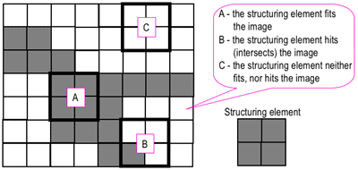
Image Morphology
Four main operations (see this tutorial)
Dilation, erosion, opening, closing
A simple series of algorithms for image transformation
Basic methodology
Choose a structuring element (e.g. 2x2 square or cross)
Move the element around the image
Apply an operation
Preparation: binary image
Pixel values 0 and 1, not [0; 255]
Result: transformed image

Slide 17
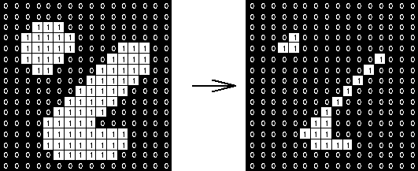
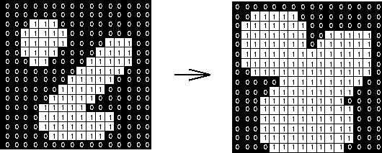

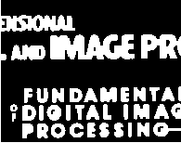
Image Morphology (2)
First get all values in the structuring element
Erosion: replace all values with the min value
Dilation: replace all values with the max value
Opening: erosion followed by dilation
Closing: dilation followed by erosion

Slide 18
Lab: Image Transformation
Get a suitable image dataset
Perform operations to prepare the data
The operations and their order depend very much on the structure of the image and the result you're trying to achieve
Experiment with different operations: image transforms (translation, rotation, scaling, shear, etc.), Fourier transformation, morphology, applying convolution filters for blurring / denoising / sharpening / edge detection, etc.
Use scikit-image
Feed the transformed image to an ML algorithm (e.g. for classification) or use one of the algorithms made to work with images
Look at the skimage gallery for inspiration

Slide 19
Summary
Text
Frequencies
Cleaning text data – stopwords, stemming
TF – IDF
Images
Image properties
Filters
Image morphology

